Slide 1
NC Retirement Plan
Business Office

Slide 2
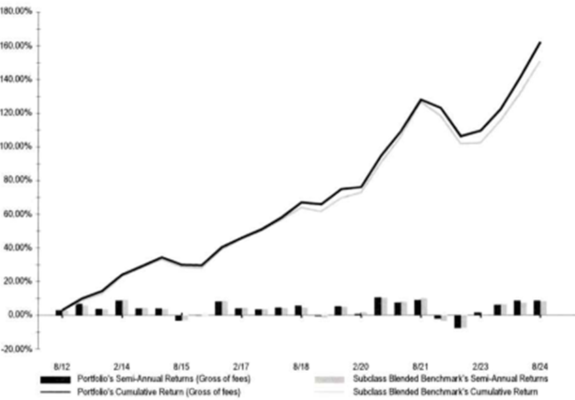
Watch the NC Retirement Plan grow as you do
Just one year of full-time work, and you’re in!
*Chart Provided by Community National Bank
Notes:
The NC Retirement Plan is an optional retirement plan available to all full-time employees who have been with the college at least one-year. The plan has shown significant growth over time and has bounced back completely following the covid damage to the economy.

Slide 3
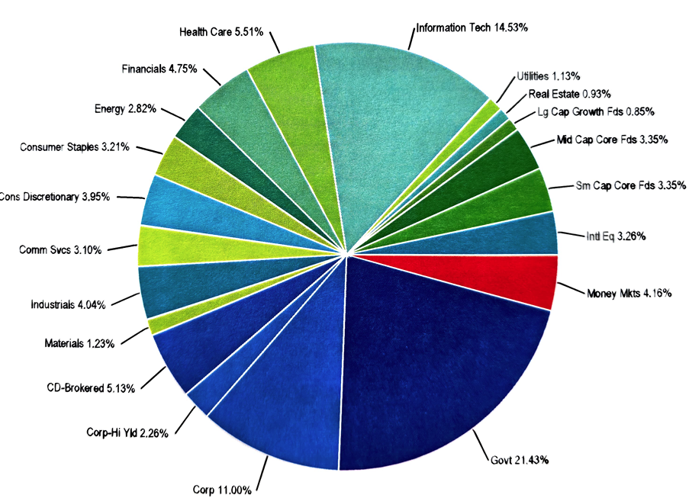
Contribute 5% and enjoy an 8% match
Fully invested in 5 years enrolled in the plan
Stay in the loop with your investment through individualized statements every 6 months
Diverse investment profile
*Chart provided by Community National Bank
Notes:
In joining NC Retirement, you will invest 5% of your salary which is matched by the college at 8%. After 5 years enrolled in the plan, you become fully vested and are entitled to the entire 8% of funds matched by the college. If you leave before the 5 years of enrollment are up, you will receive a percentage of the matched funds based on the length of enrollment. Statements are prepared for each individual’s account every 6 months by our plan management team at July Business Services in Waco. Our investment partners at Community National Bank maintain a diverse portfolio and make adjust as needed based on the stock market. Community National Bank meets with the Dr. Fegan and the NC Retirement Committee to give plan status and market updates, as well as answering any questions.

Slide 4
For NC Retirement Plan Applications or Retirement Forms
Executive Administrative Assistant to the VP of Finance
Megan Smith
megan.smith@navarrocollege.edu
903-875-7645

Slide 5
Payroll
Business Office

Slide 6
Final Paycheck:
Your final paycheck will include unused vacation/compensatory hours.
Any unused sick leave will be paid out according to NC Policy.
Notes:
Upon leave of employment whether voluntary, terminated, or retiring the final paycheck will include all unused vacation and compensatory hours. If you meet the criteria for years of service according to Navarro College’s policy you will also be compensated for sick time accumulated at the percentage allotted by the compensation policy.

Slide 7
Faculty
Compensated for the earned amount of your contract.
Final paycheck will be issued by direct deposit on your next normal pay date.
Please note if you do not have direct deposit set up at the time of payroll, your paycheck will be mailed to your mailing address on file.
Notes:
Are compensated for the earned amount of your contract on your final paycheck if applicable.
Final paycheck will be issued to you by direct deposit on your next normal pay date.
Please note if you do not have direct deposit set up at the time of payroll, your paycheck will be mailed to your mailing address on file.

Slide 8
TRS
Business Office

Slide 9
TRS (Retirement):
Submit a TRS 18 form through MyTRS account, mail or fax.
Employer contacted to confirm retirement details.
TRS processes retirement within 31 days of receiving complete packet.
Notes:
You can request your retirement packet by submitting a TRS 18 form to them. You can submit this form by logging into your MyTRS account. If you do not have a MyTRS account, mail or fax a completed TRS 18 (https://www.trs.texas.gov/TRS%20Documents/form_18.pdf) to TRS.
Once you complete your retirement packet and return it to TRS, TRS will contact your employer(s) near your retirement date to confirm your retirement date and final salary information. Please note that TRS processes applications for retirement within 31 days of receipt.

Slide 10
TRS (Rollover):
TRS 6A form required (signed by receiving plan)
Refund issued after all paperwork and final deposits confirmed
Refund not processed if re-employed by a TRS-covered employer
Notes:
TRS (Rollover):
If you would like to roll over all or part of your refund, TRS will send you an additional TRS 6A form to complete and return to them. The representative of the retirement plan receiving your rollover must also sign the form to verify that the plan is eligible to receive the rollover of funds.
After TRS receives all required documents, and your account has been reconciled with the last deposits from your employer(s), TRS will issue you a refund payment. The payment will not be processed if records show that you have been re-employed by a TRS-covered employer.

Slide 11
TRS (Refund):
Must permanently terminate employment and not plan to return
Submit notarized TRS 6 form via MyTRS, mail, or fax
TRS confirms termination and final contributions with employer
Notes:
TRS (Refund):
If you permanently terminate employment with your TRS-covered employer(s) and have neither applied for nor received a promise of employment with a TRS-covered employer, you may terminate membership in TRS and withdraw all of the accumulated contributions (plus interest) in your member account. Partial withdrawals are not allowed.
You can request a refund by logging into your MyTRS account. If you do not have a MyTRS account, mail or fax a completed TRS 6 form (https://www.trs.texas.gov/TRS%20Documents/form_6.pdf) to TRS.
Please note that you must have this form notarized. TRS may contact your previous employer(s) to confirm your date(s) of termination and final monthly contributions.

Slide 12
ORP
Business Office

Slide 13
Contact Voya to begin retirement, refund, or rollover
Post-retirement, Voya sends a form to complete
Voya confirms retirement date with employer
Notes:
Employees should contact Voya at the below number to initiate the retirement, refund, ore rollover process. After the retirement date has passed, they will send you a form to complete. Voya will contact your employer to certify your retirement date.

Slide 14
For Payroll, TRS, or ORP questions, reach out to the Business Office for assistance.
Payroll Manager
Alison Skinner
alison.skinner@navarrocollege.edu
903-875-7325

Slide 15
Employees Retirement System (ERS for Insurance)
Human Resources
Notes:
ERS is related to your benefits. The next slides are going to cover some important information on behalf of the Benefits Coordinator, but please reach out to HR with any ERS related questions.

Slide 16
Submit resignation in Oracle
At least 90 days prior to retirement meet with Benefits Coordinator for a Retiree Insurance Enrollment Form
If you would like automatic withdrawal of premiums complete the form Automatic Withdrawal
Return form(s) to Benefits Coordinator for submission to ERS
Notes:
Make sure to submit a resignation in Oracle. At least 90 days prior to your retirement date, contact and inform the Benefits Coordinator so you can be given a Retiree Insurance Enrollment Form. At least 90 days prior to your retirement date, contact and inform the Benefits Coordinator so you can be given a Retiree Insurance Enrollment Form. If you would like to have premiums automatically paid, you will also need to fill out an Automatic Withdrawal Form. Once complete return all forms required to the Benefits Coordinator for submission to ERS.

Slide 17
ERS will process retirement information and confirm eligibility
Employee will receive a Retiree Insurance Enrollment Statement in the mail showing:
Coverage you are enrolled in
Options for changing coverage which include medical, dental, vision, and life insurance
You have 30 days after your retirement date to elect or make changes to your insurance (if eligible)
Notes:
ERS will process all retirement information and confirm eligibility with Navarro. The employee will then receive a Retiree Insurance Enrollment Statement from ERS showing coverage you are enrolled in and options for changing your medical, dental, vision, and life insurance coverage selections. You have up to 30 days after your retirement date to elect or make changes to your life insurance (if eligible).

Slide 18
If you have any ERS benefit related questions, reach out to Human Resources for assistance.
Benefits Coordinator
Peggie Henderson
peggie.henderson@navarrocollege.edu
903-875-7474
Human Resources Specialist
Riva Bryant
riva.bryant@navarrocollege.edu
903-875-7335

Slide 19
Bulldogs Forever
Human Resources

Slide 20
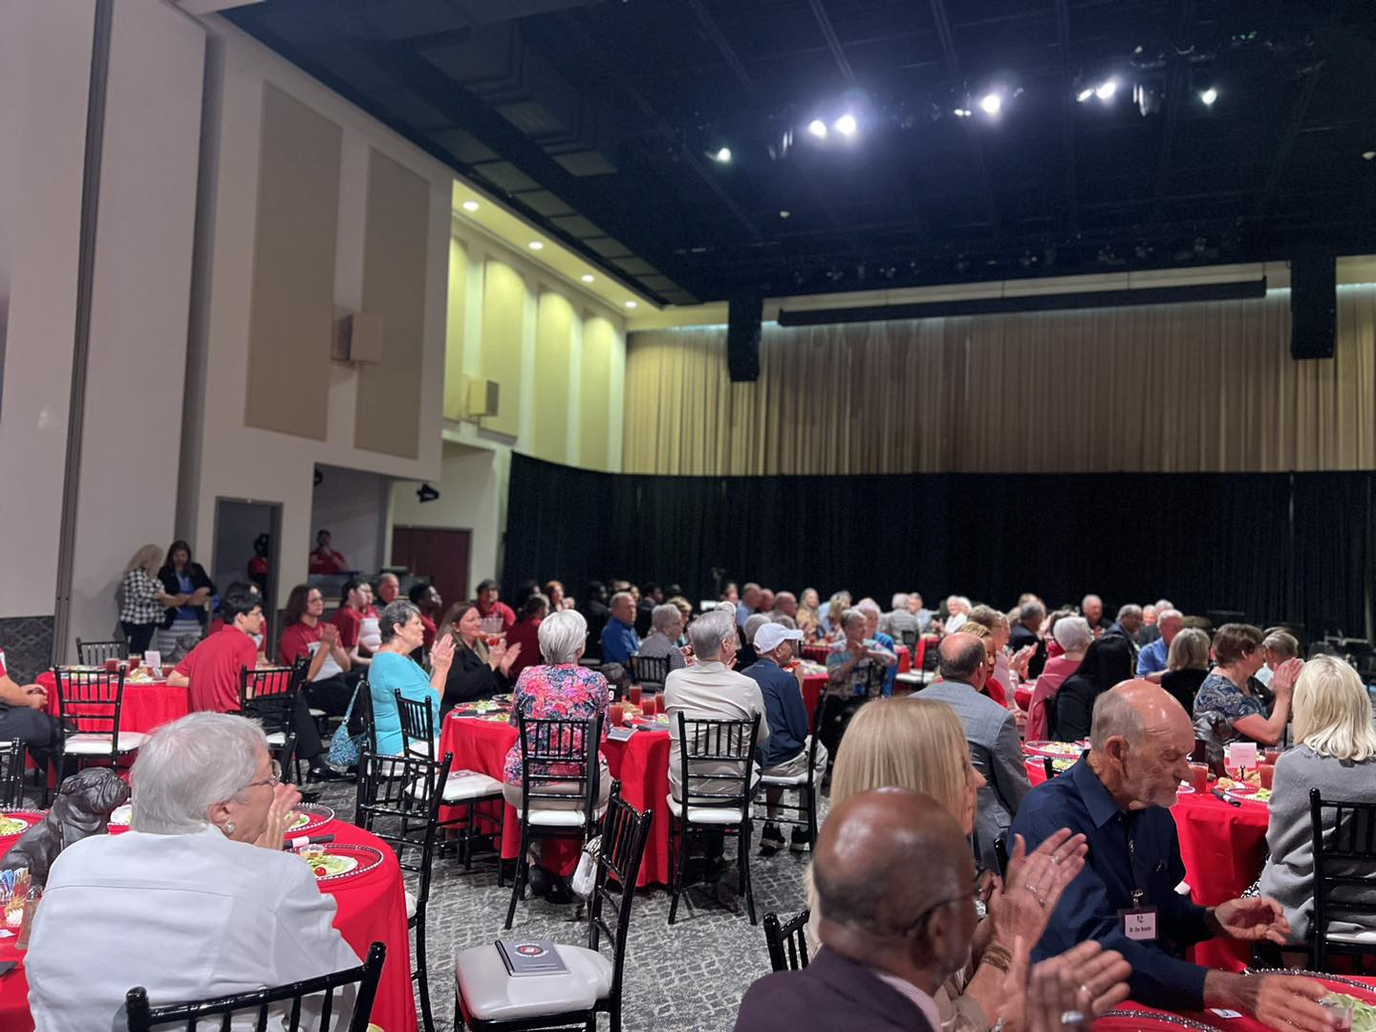
Leaving soon, and want to be invited to the Annual Bulldogs Forever Retiree Luncheon?
Please contact Michelle Smith with a current mailing address and a personal email address to join!
michelle.smith@navarrocollege.edu or 903-875-7640

